Slide 1
The Atlantic Ocean
Exploring the Wonders of the Atlantic Ocean

Slide 2
Introduction
The Atlantic Ocean is the second-largest ocean on Earth, covering approximately 20% of the planet's surface.
It separates the continents of North and South America from Europe and Africa and plays a vital role in shaping the climate and weather patterns of the surrounding regions.
Let's dive deeper into the fascinating features and marine life of the Atlantic Ocean.

Slide 3
Geography and Size
The Atlantic Ocean stretches over an area of about 41 million square miles.
It is bordered by the Americas to the west and Africa and Europe to the east, encompassing numerous countries and islands.
The North Atlantic and South Atlantic are divided by the equator, resulting in differences in temperature and marine ecosystems.

Slide 4
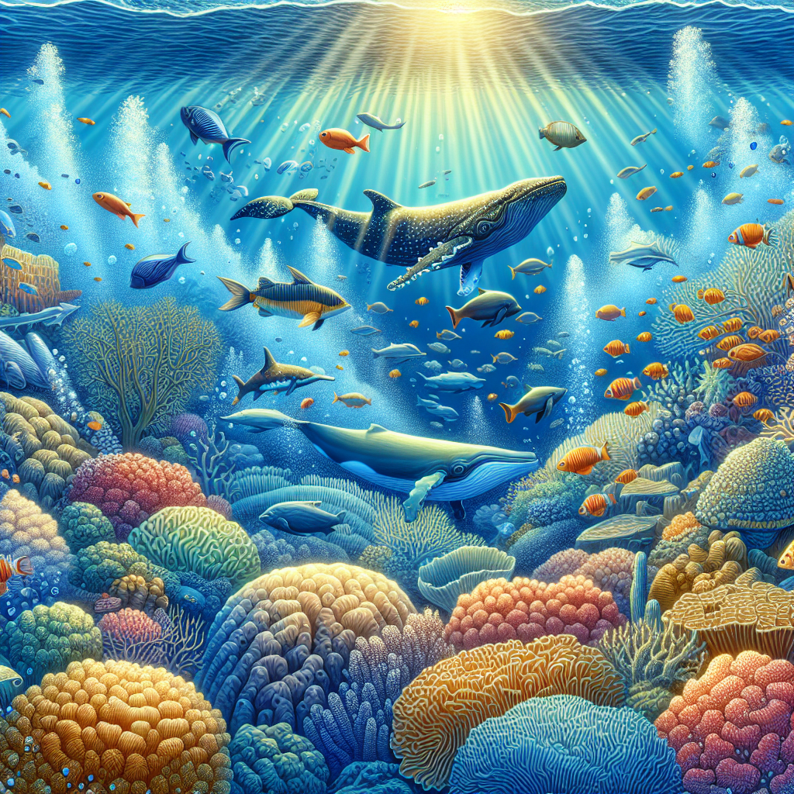
Marine Life
The Atlantic Ocean is home to a rich diversity of marine life.
Its waters support various species of fish, including cod, tuna, and herring.
Other notable inhabitants include whales, dolphins, sharks, and colorful coral reefs.
Diverse Marine Life in the Atlantic Ocean

Slide 5
Historical Significance
The Atlantic Ocean has played a crucial role in human history and exploration.
It was a major route for early European explorers, such as Christopher Columbus, as they discovered new lands and established colonial empires.
The Atlantic Ocean also witnessed significant events during World War II, including naval battles and the sinking of ships.

Slide 6
Ocean Currents
The Atlantic Ocean is known for its strong ocean currents.
The Gulf Stream, one of the most powerful currents, influences the climate of nearby countries and plays a role in the transportation of heat and nutrients.
These currents also affect marine ecosystems and the distribution of species.

Slide 7
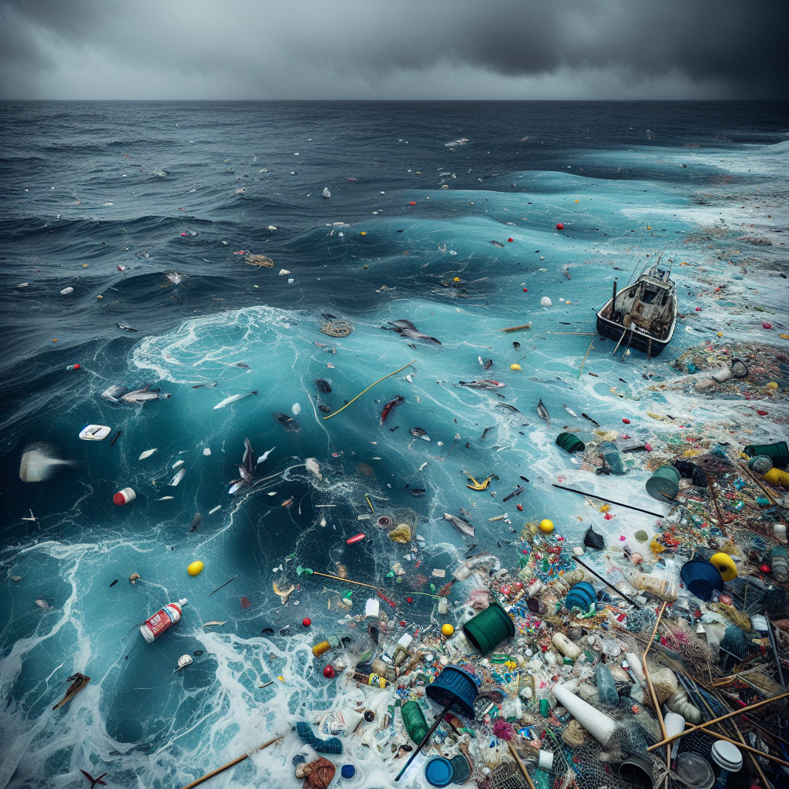
Environmental Concerns
The Atlantic Ocean faces environmental challenges due to human activities.
Issues such as overfishing, pollution, and plastic waste pose threats to marine life and ecosystems.
Efforts are being made to address these concerns and promote sustainable practices to preserve the Atlantic Ocean.
Environmental Challenges in the Atlantic Ocean

Slide 8
Recreational Activities
The Atlantic Ocean offers abundant opportunities for recreational activities.
Popular activities include swimming, surfing, sailing, and deep-sea fishing.
Coastal regions along the Atlantic Ocean attract tourists and provide leisure options for both locals and visitors.

Slide 9
Island Paradises
The Atlantic Ocean is adorned with numerous captivating islands.
From the tropical beauty of the Caribbean islands to the rugged landscapes of the Azores, these destinations offer unique experiences and breathtaking natural beauty.
Exploring these island paradises is a dream for many travelers.

Slide 10
Conclusion
The Atlantic Ocean holds immense significance and beauty.
With its diverse marine life, historical importance, and environmental challenges, it continues to capture our fascination.
Let's appreciate and protect this vast ocean for future generations.

Slide 11
References
1. National Geographic Society. 'Atlantic Ocean.'
2. World Wildlife Fund. 'Atlantic Ocean.'
3. Encyclopaedia Britannica. 'Atlantic Ocean.'

Slide 12
Thank You
Thank you for exploring the wonders of the Atlantic Ocean!
Any questions?

